Slide 1
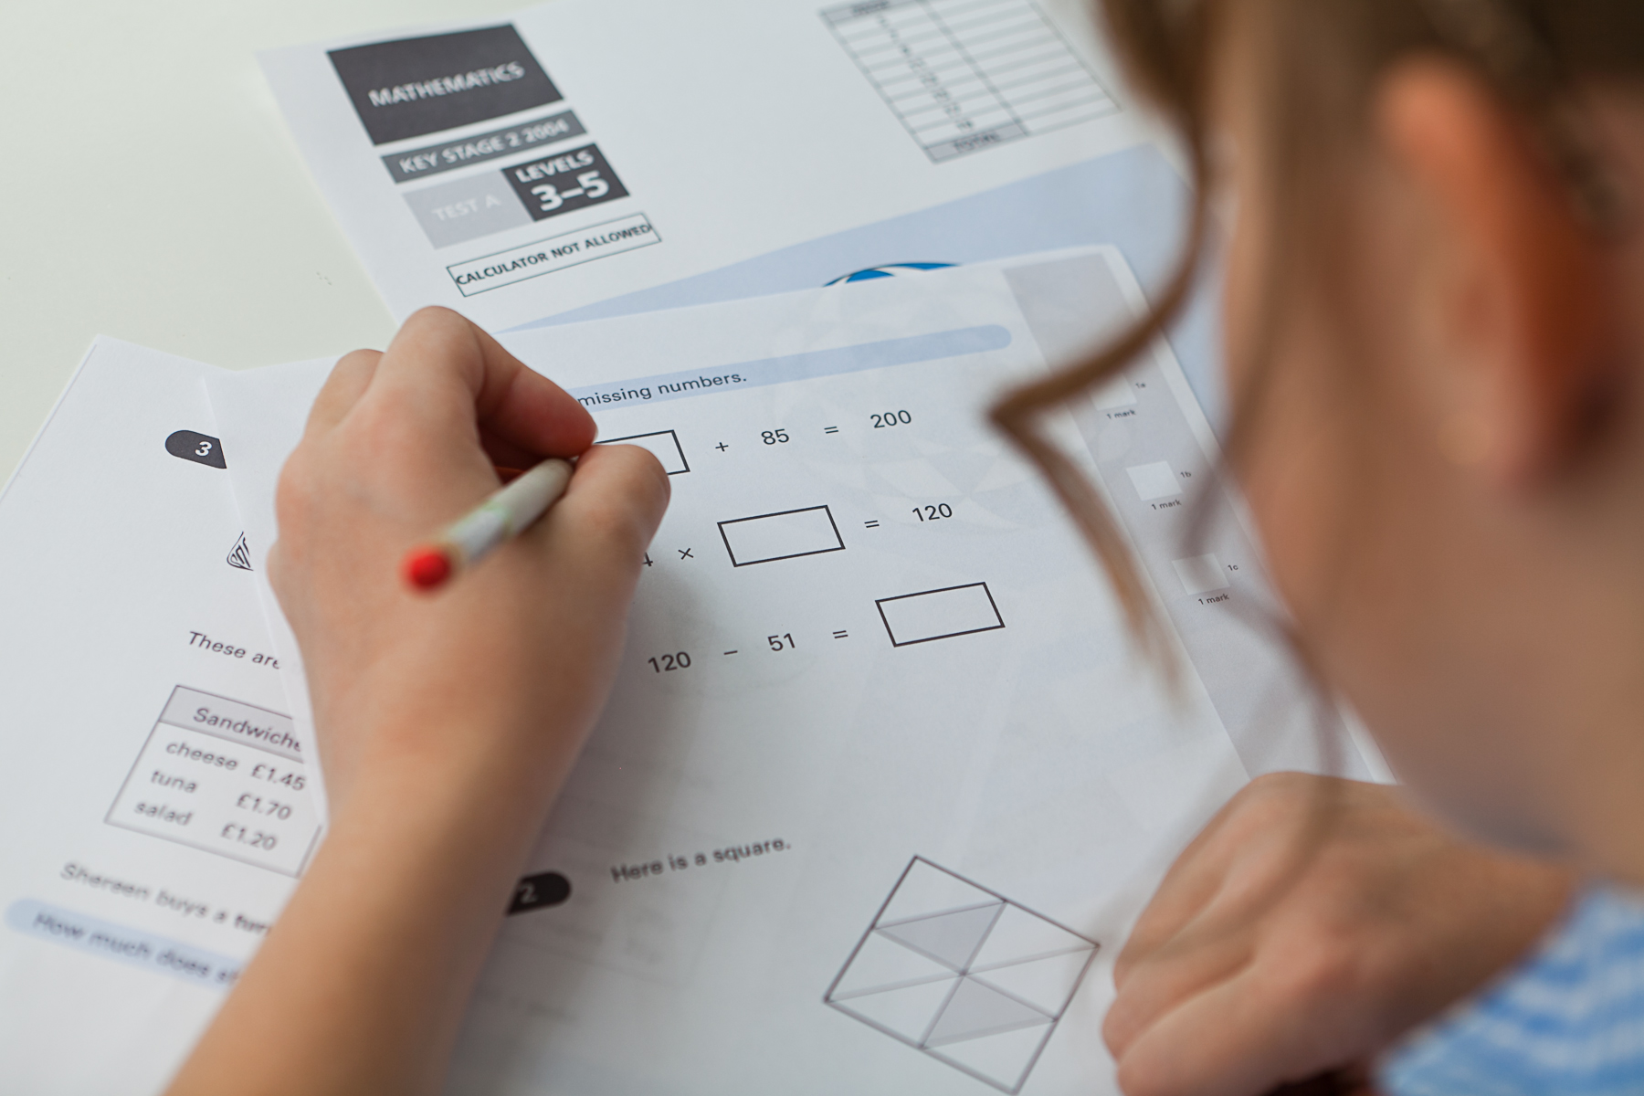
Key Stage Two SATs Information
Workshop for Parents
Mr Evans

Slide 2
Although a few years old, this video is a great place to start for information about SATs
https://youtu.be/532MUvA81tM

Slide 4
Scaled Scores
What is meant by ‘Scaled scores’?
It is planned that 100 will always represent the ‘National standard’.
Each pupil’s raw test score will therefore be converted into a score on the scale, either at, above or below 100.
Using the scaled score, the lowest a child can score is 80, with the highest being 120.
A child who achieves the ‘National standard’ (a score of 100) will be judged to have demonstrated sufficient knowledge in the areas assessed by the tests.
Each pupil receives:
a raw score (number of raw marks awarded);
a scaled score in each tested subject;
confirmation of whether or not they attained the national standard.

Slide 5
Scaled Score Examples
On publication of the test results in July:
a child awarded a scaled score of 100 is judged to have met the ‘National standard’ in the area judged by the test;
If a child’s score is close to 120, they are working beyond (or above) the expected National standard. (110)
a child’s score is close to 80, they are judged to have not yet met the National standard and per- formed below the expectation for their age.

Slide 6
Key Stage 2 SATs take place nationally in the week commencing 13th May 2024
Statutory tests will be administered in the following subjects:
Punctuation, Vocabulary and Grammar (45 minutes)
Spelling (approximately 15 minutes)
Reading (60 minutes)
Mathematics
- Paper 1: Arithmetic (30 minutes)
- Paper 2: Reasoning (40 minutes)
- Paper 3: Reasoning (40 minutes)
All tests are externally marked.
Writing will be teacher assessed internally. The revised ‘pupil can’ statements for English writing place a greater emphasis on composition and the statements that relate to the more ‘technical’ aspects of English writing (grammar, punctuation and spelling) have been made less prescriptive.
The Tests

Slide 7
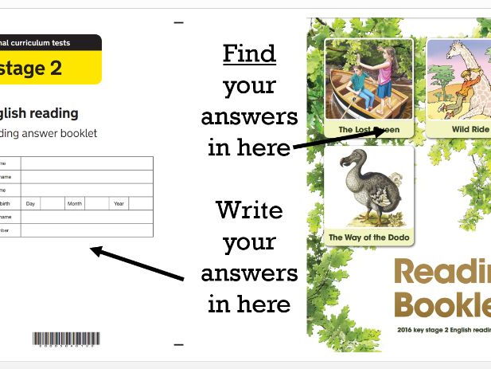
Reading
The reading test consists of a single test paper with three unrelated reading texts. Children are given 60 minutes in total, which includes reading the texts and answering the questions.
A total of 50 marks are available.
Questions are designed to assess the comprehension and understanding of a child’s reading.
During the reading paper, a child’s inference and deduction skills are thoroughly tested. They will also be expected to answer questions on authorial choices: explaining why an author has chosen to use particular vocabulary, grammar and text features.
Some questions are multiple choice or selected response; others require short answers and some require an extended response or explanation.
Reading

Slide 8
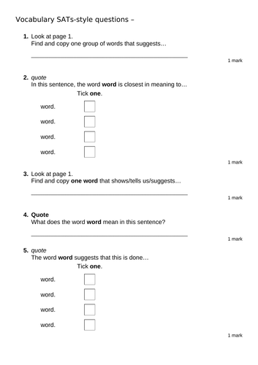
Sample Questions
Reading Paper

Slide 9
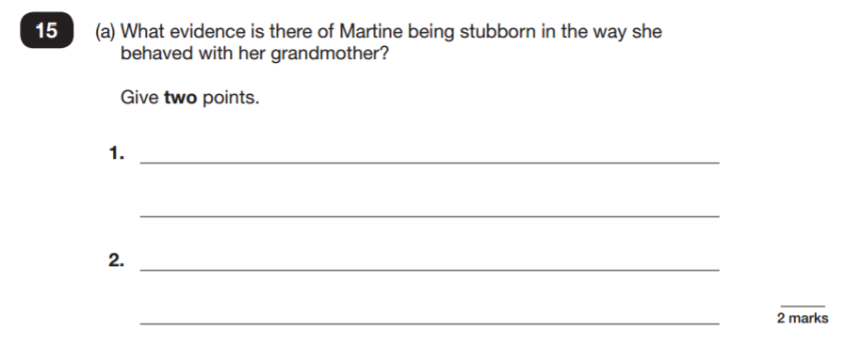
Sample Questions
Reading Paper

Slide 10
The Pattern of letters, words that help us to… READ! Reading is like a high-spede geussing game in which the readers brain tries to maek sence out of the funny black mraks on the paeg. It’s the brian that dose the wrok not the boook. So even all if words the the on page get midex pu te bniar can ususayll wrok out what shud be ther. Clever tihng, the brian. - from “The Languages Book” published by The English and Media Centre
Notes:
The importance of comhension!

Slide 11
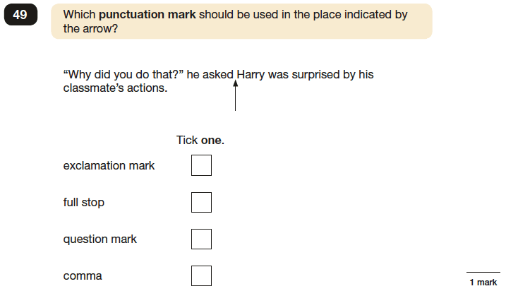
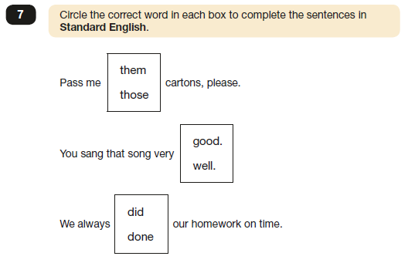
SPAG/GPS Grammar, Punctuation and Spelling
A spelling test is administered containing 20 words, which lasts approximately 15 minutes.
A separate test is given on grammar, punctuation and vocabulary.
This test lasts for 45 minutes and requires short answer questions including some multiple choice.
Marks for these two tests are added together to give a total for grammar, punctuation and spelling. Out of 70 marks

Slide 12
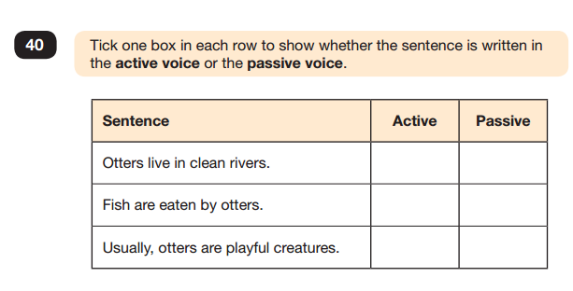
Grammar, Punctuation and Spelling Paper 1

Slide 13
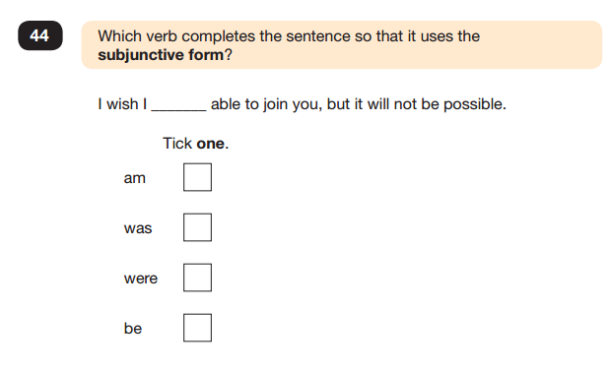
Grammar, Punctuation and Spelling Paper 1

Slide 14
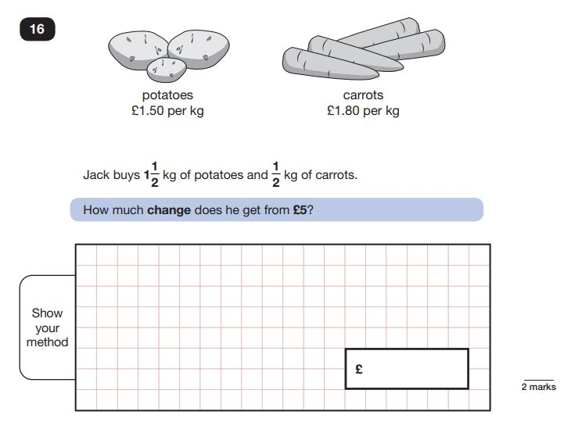
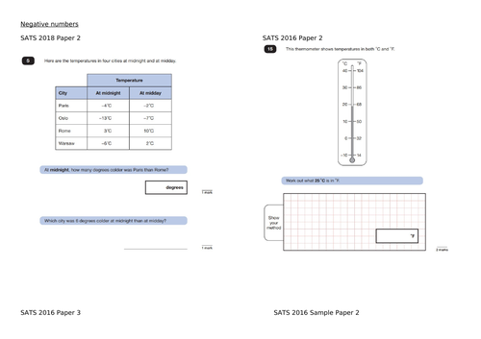
Mathematics
Children will sit three tests: paper 1, paper 2 and paper 3.
Paper 1 is for arithmetic lasting for 30 minutes, covering calculation methods for all operations, including use of fractions, percentages and decimals.
Questions gradually increase in difficulty. Not all children will be expected to access some of the more difficult questions later in the paper.
Papers 2 and 3 cover problem solving and reasoning, each lasting for 40 minutes.
Pupils will still require calculation skills but will need to answer questions in context and decide what is required to find a solution.

Slide 15
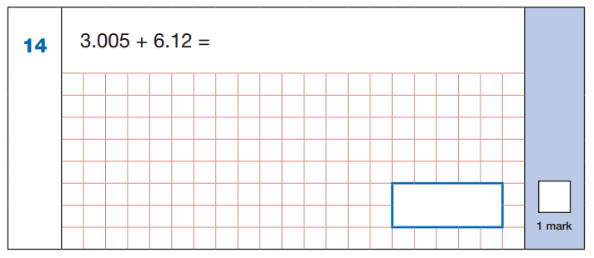
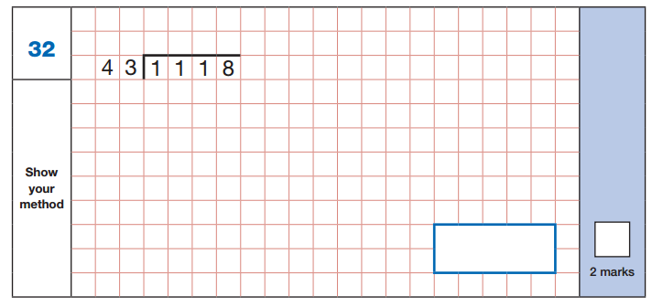
Maths Paper 1: Arithmetic

Slide 16
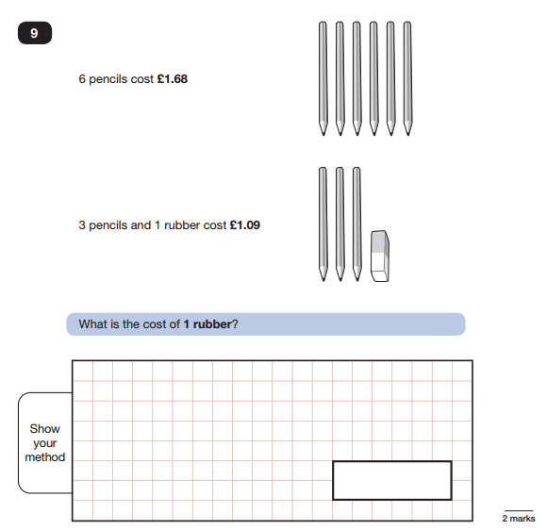
Maths Paper 2 / Paper 3 : Reasoning

Slide 17
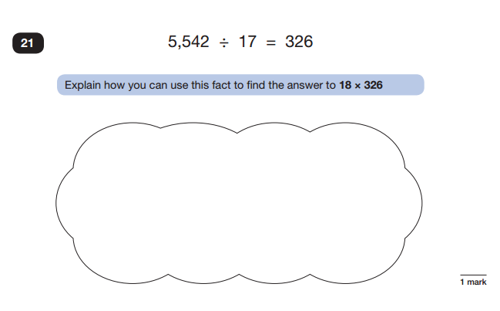
Maths Paper 2 / Paper 3 : Reasoning

Slide 18
Thresholds…
Reading /50 | 2019 | 2022 | 2023
Expected | 28 | 29 | 24
Greater Depth | 41 | 41 | 38
Maths /110 | 2019 | 2022 | 2023
Expected | 58 | 58 | 56
Greater Depth | 95 | 96 | 94
Grammar /70 | 2019 | 2022 | 2023
Expected | 36 | 35 | 36
Greater Depth | 55 | 55 | 55

Slide 19
First and foremost, support and reassure your child that there is nothing to worry about and they should always just try their best. Praise and encourage!
Ensure your child has the best possible attendance at school.
Support your child with any homework tasks.
Reading, spelling and arithmetic (e.g. times tables) are always good to practise.
Talk to your child about what they have learnt at school and what book(s) they are reading (the character, the plot, their opinion).
Make sure your child has a good sleep and healthy breakfast every morning!
How to Help Your Child

Slide 20
Listening to your child read can take many forms.
First and foremost, focus developing an enjoyment and love of reading.
Enjoy stories together – reading stories to your child at KS1 and KS2 is equally as important as listening to your child read.
Read a little at a time but often, rather than rarely but for long periods of time!
Talk about the story before, during and afterwards – discuss the plot, the characters, their feelings and actions, how it makes you feel, predict what will happen and encourage your child to have their own opinions.
Look up definitions of words together – you could use a dictionary, the internet or an app on a phone or tablet.
All reading is valuable – it doesn’t have to be just stories. Reading can involve anything from fiction and non-fiction, poetry, newspapers, magazines, football programmes, TV guides.
Visit the local library - it’s free!
How to Help Your Child with Reading

Slide 21
Practise and learn the weekly spelling lists and the Year 5/6 key words – make it fun!
Encourage opportunities for writing, such as letters to family or friends, shopping lists, notes or reminders, stories and poems.
Write together – be a good role model for writing.
Encourage use of a dictionary to check spelling and a thesaurus to find synonyms and expand vocabulary.
Allow your child to use a computer for word processing, which will allow for editing and correcting of errors without lots of crossing out.
Remember that good readers become good writers! Identify good writing features when reading (e.g. vocabulary, sentence structure and punctuation).

Slide 22
Play times tables games.
Play mental maths games including counting in different amounts, forwards and backwards.
Encourage opportunities for telling the time.
Encourage opportunities for counting coins and money; finding amounts or calculating change when shopping.
Look for numbers on street signs, car registrations and anywhere else! Ask you children what they can tell you about those numbers… is it odd? Even? Square? Prime?
Look for examples of 2D and 3D shapes around the home.
Identify, weigh or measure quantities and amounts in the kitchen or in recipes.
Play games involving numbers or logic, such as dominoes, card games, darts, draughts and chess.

Slide 23
Help at home
https://www.satspapersguide.co.uk/
http://www.bbc.co.uk/education
http://www.educationquizzes.com/ks2/maths/
http://www.icteachers.co.uk/children/children_sats.htm
http://www.online-maths-tutor.com/
http://www.mathplayground.com/games.html

