Slide 1
Year 6 Residential

Slide 2
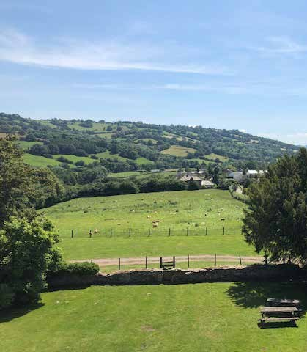
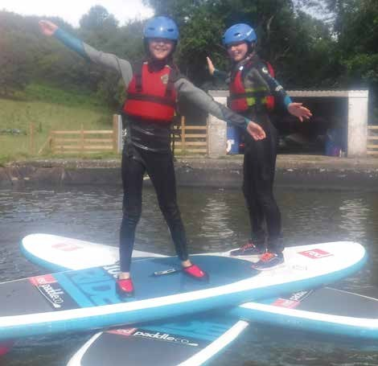
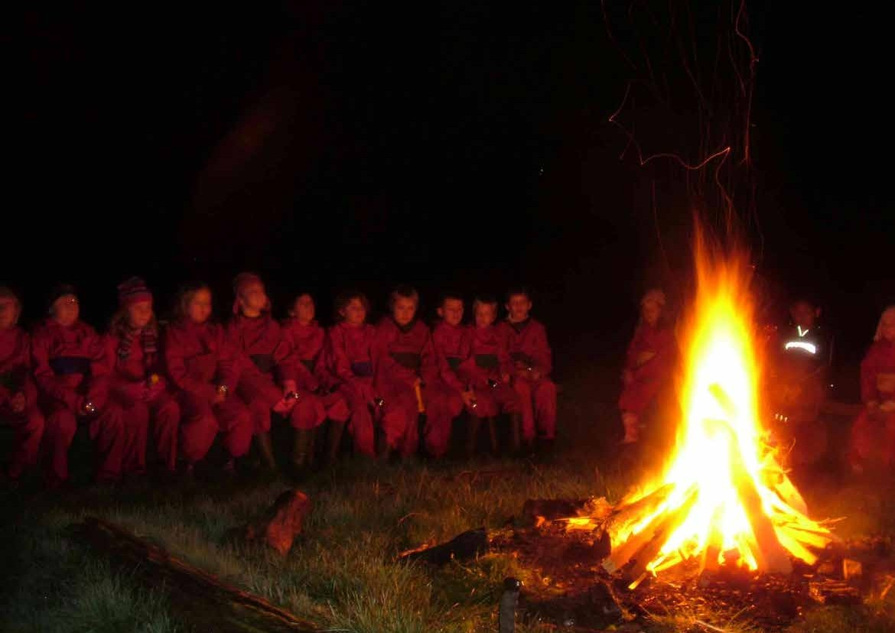

Slide 3
On the day we leave:
Arrive at school on the day from 8:30am in clothes to travel in.
Enter through the main doors and place all bags in the hall.
Any medication your child may need will be signed in.
Leave approx. 9am
It is roughly a 4 hour journey – the coach normally drives for around 2 and a half hours and then stop at a service station.
I will inform the school when we have arrived.
You will need a packed lunch for Monday in a disposable bag that we can bin plus a drink in a water bottle that can handle a bump or two

Slide 4
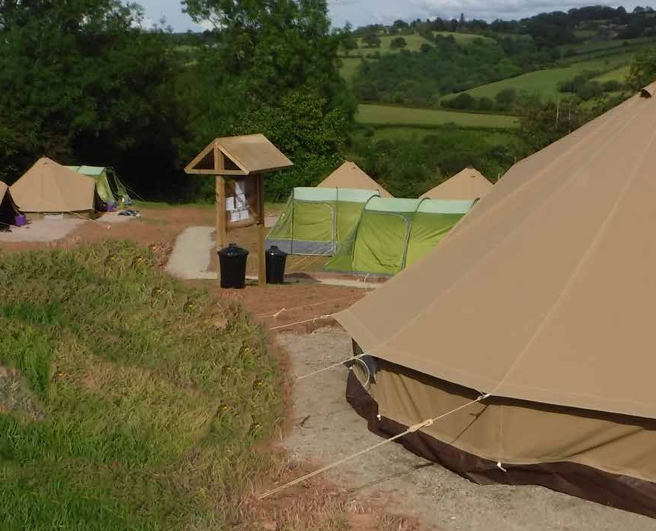
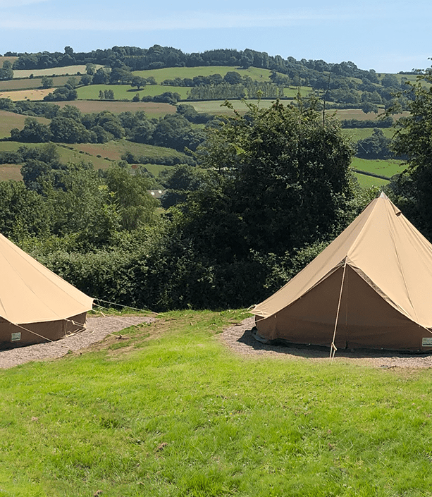
ARRIVAL
When you arrive you will:
Do a safety walk
Choose tents

Slide 5
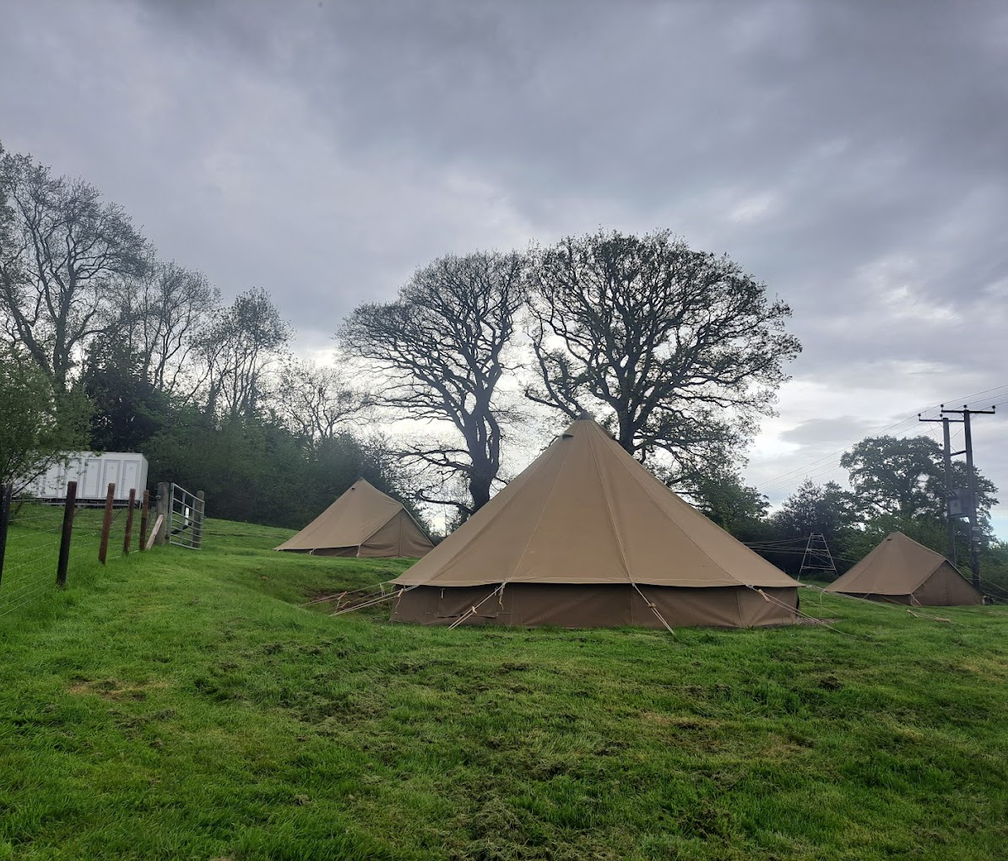
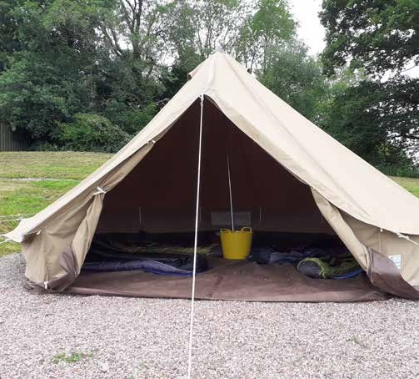
Tents

Slide 6
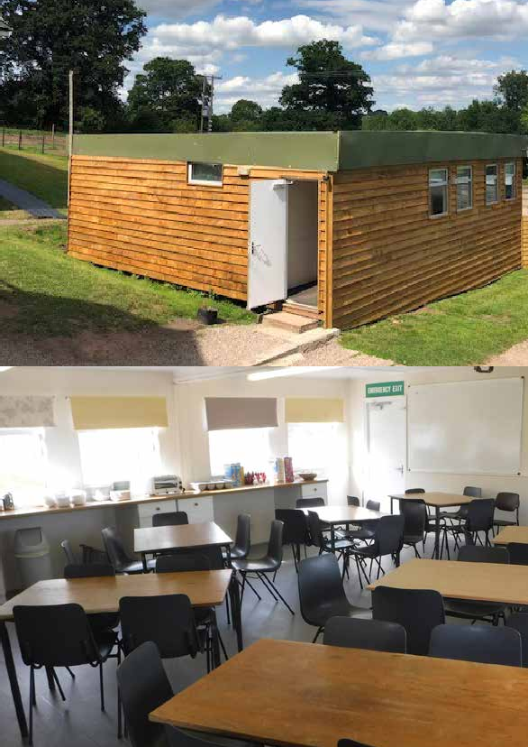
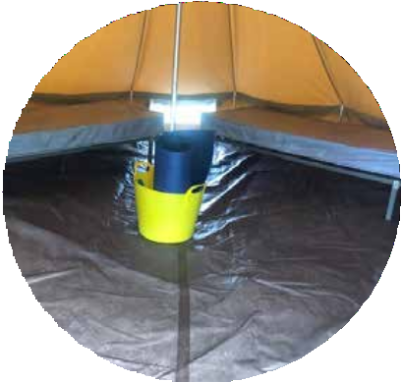
Timings/Food
Breakfast: 7:30am – cereal, toast, fruit
Lunch: after breakfast the children will make their own packed lunch (ham/cheese/tuna)
Dinner: around 6pm ish
Dinner is normally things such as: spag bol, sausage and chips, non-spicy curry etc.
FOOD

Slide 7
Activities:

Slide 8
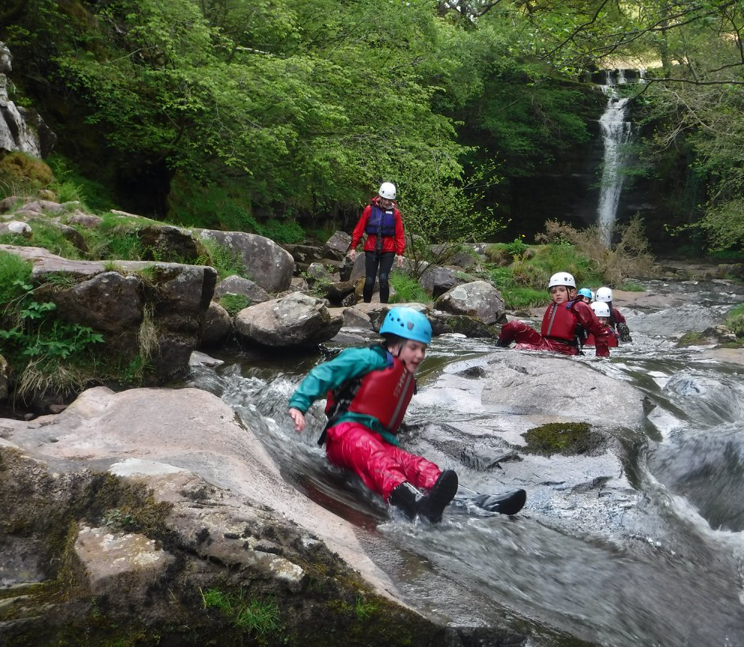
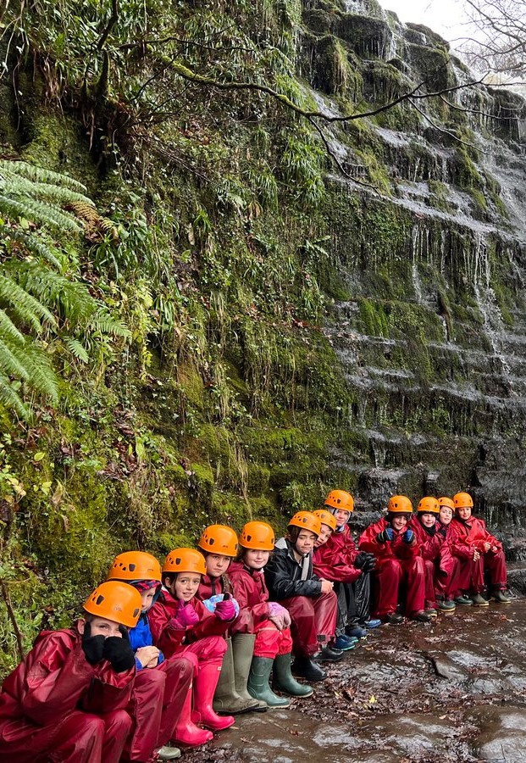
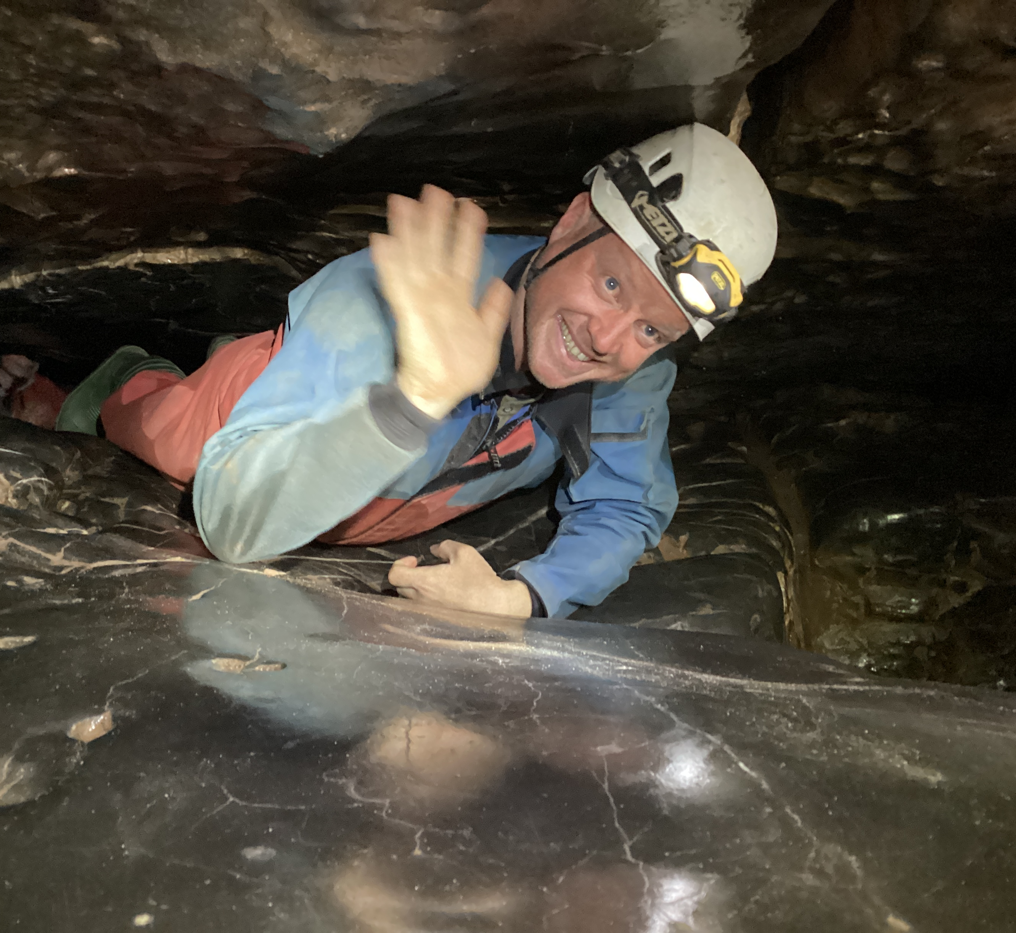
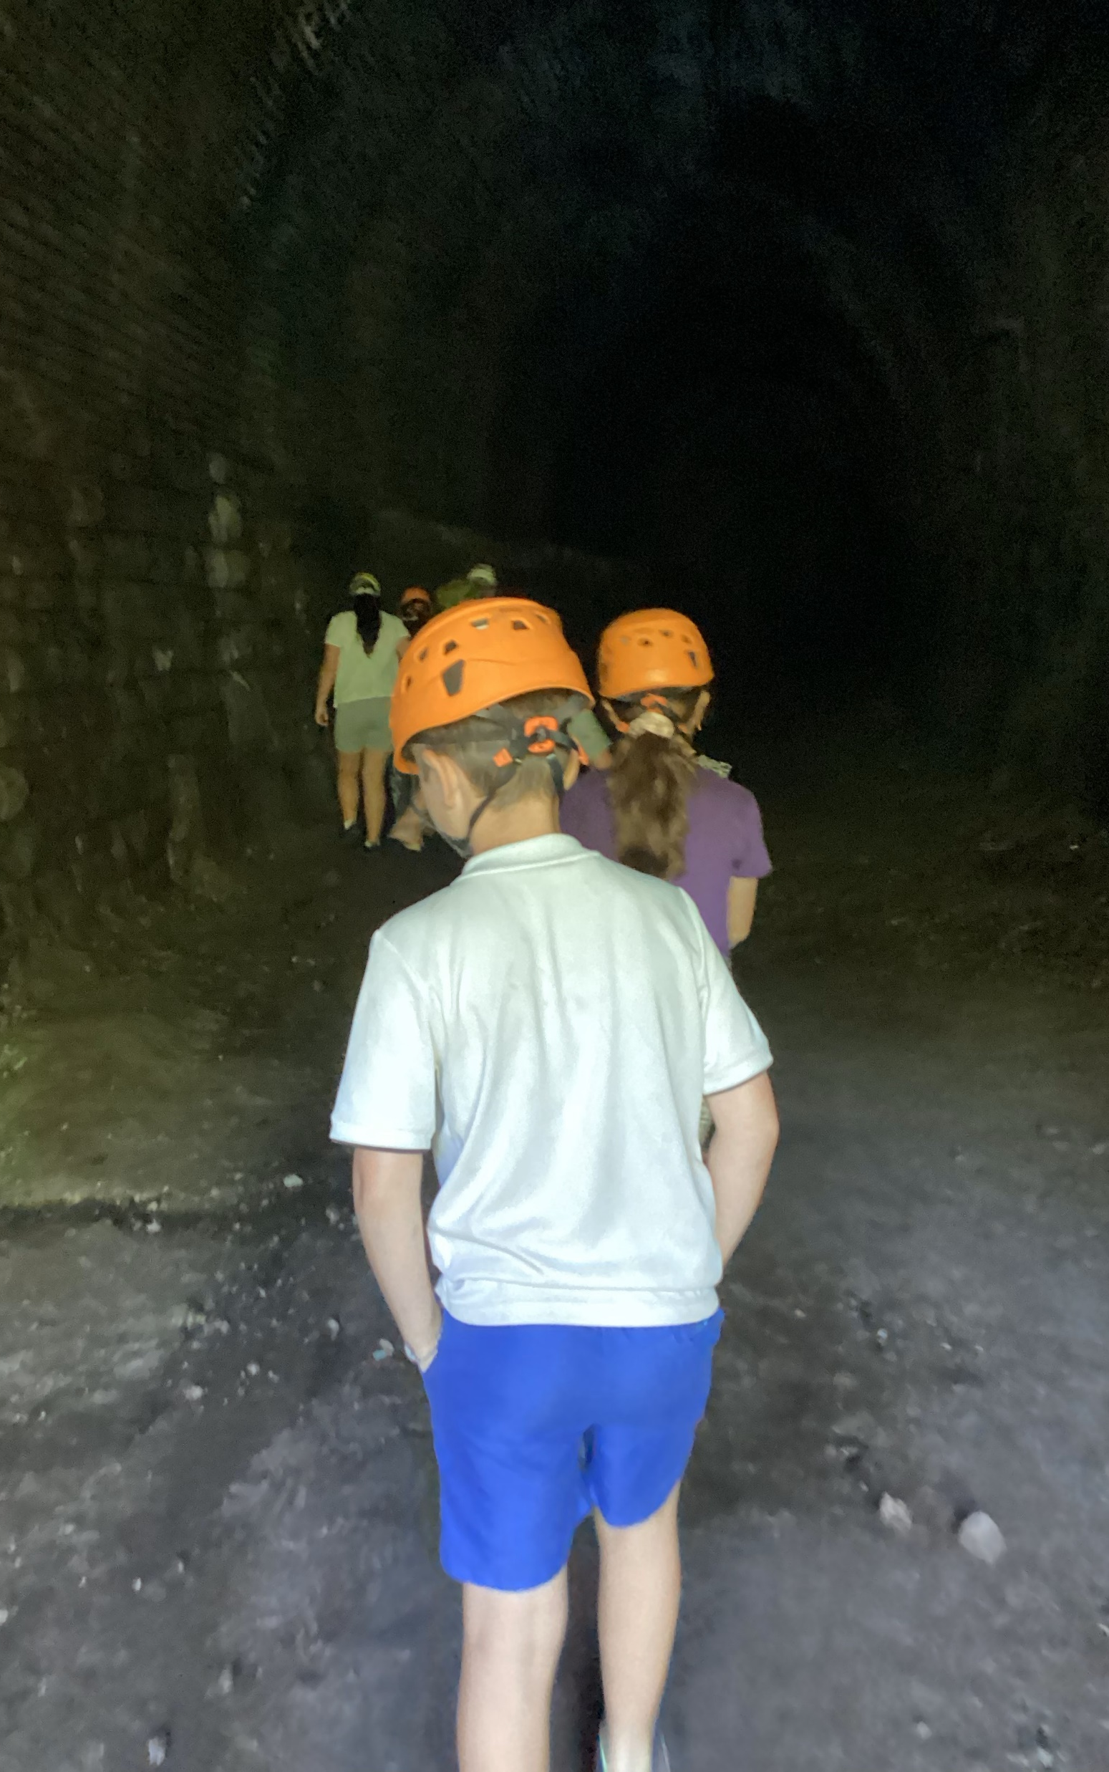
Gorge walking
Caving

Slide 9
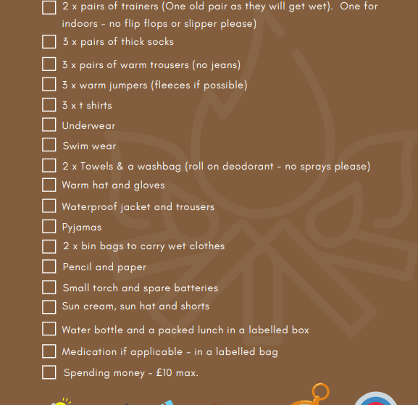
Kit List
Old clothes
Old trainers
Tight t-shirt (boys(/swimming costume (girls)
£10 spending money
Sun cream and hat
Thin waterproof
Sleeping bag and pillow
2 towels
2 x bin bags
Torch
Sweets/snacks
Games for free time
Flip-flops/sandals/crocs/sliders
Water bottle

Slide 10
Return leg (yes I will have to bring them home at some point… sorry):
Leave at around 12pm, but if the coach arrives sooner we will leave when ready.
We will arrive back to school at around 4:30pm (traffic dependent)
Hugs and embraces from parents

Slide 11
AOB
Photo permission
Emergency care
Dietary needs
Medical needs
Nearest hospitals: Hereford for A and E. Nevill Hall for minor incidents or The Grange for more serious A and E requirements.
Electrical devices
Wifi permitting, there will be daily updates either late at night or first thing in the morning

