Slide 1
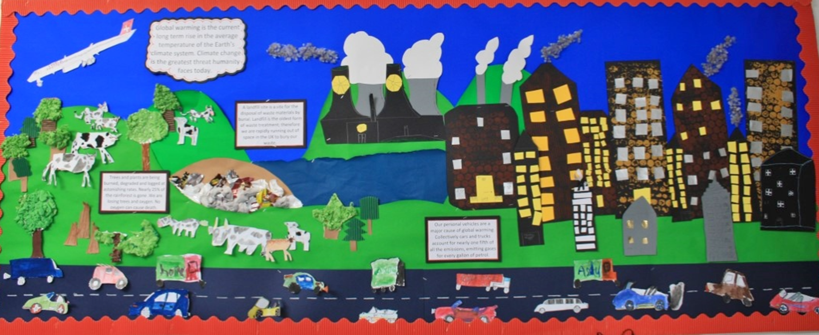
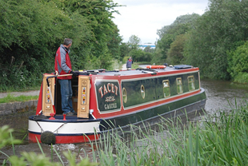
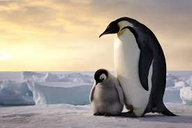
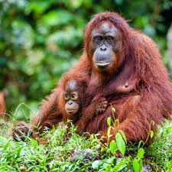
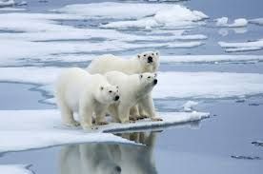
Welcome to Year 4
Autumn Term 1
Climate Change & Transport
.
Draw or paint a Canal boat scene. Compare a canal in Northamptonshire with one in another country. | Research two European countries. Compare 3 things that the countries are proposing on doing to improve the environment. Which one do you think is doing the most? | Round the following numbers to the nearest ten: 17 81 124 13 55 131 52 99 515 76 107 704
Write your age in Roman numerals. Now, using Roman numerals, can you write the age of other family members? | Research the Emperor penguin and how climate change has affected its habitat and breeding. | Name a species affected by climate change. Describe its habitat and why it is affected.
Can you write a sentence using the homophones correctly: Aloud / allowed Bear /bare Hear /here Whole / hole Sea / see | Write down your times table facts for: Twos Fours Eights Do you notice any patterns to help you remember these times tables? | Create a poster giving information about the Hindu religion – include words and symbols that are important to Hindus.

