Slide 1
Welcome to Year 1
Miss Sartain

Slide 2
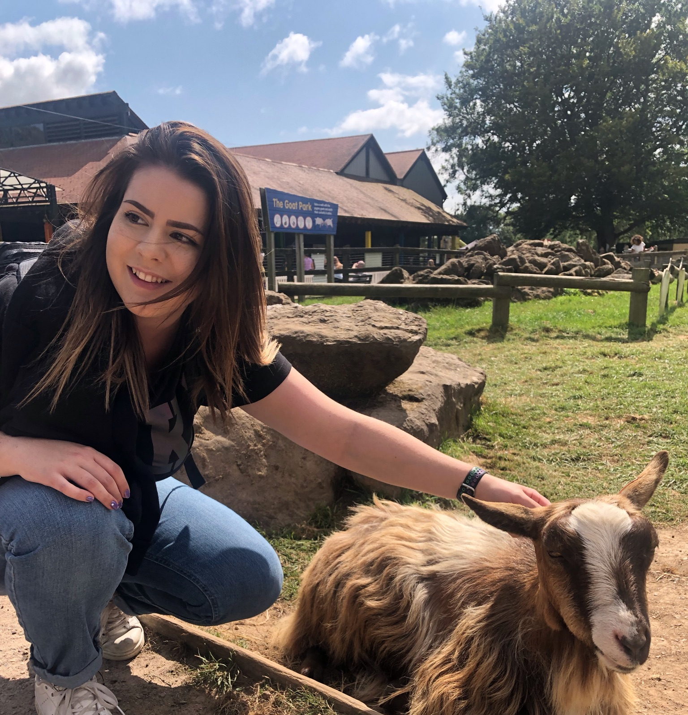
A little about me…
I have worked at Cogenhoe since 2021, initially as a student teacher and now as a fully qualified teacher.
I have a son called Harvey who is 6 Years old.
I also have a crazy dog called Dexter who I adore very much.
I am a huge fan of chocolate… especially galaxy.
The colour purple has my heart ☺

Slide 3
Lessons
The children will take part in one Maths lesson, one Literacy lesson, one handwriting lesson and one phonics lesson every day.
They will also study other curriculum areas such as;
Science
History and Geography (topic)
Art and D.T.
P.S.H.E
RE
Music
P.E.
Computing

Slide 4
Maths
Maths lesson are every day after phonics in the mornings.
In Year 1, we start off the year with our approach to continuous provision. This means there will be an adult working with a small group of children for the majority of their maths work.
We work on the premise that it is imperative to ask important questions as this can extend the children's thinking and learning.

Slide 5
Maths Continued…
By the end of the year the government expectation is that they know their 2’s,5s and 10 times table, and should be able to count forwards and backwards to 100 independently.
These will be focussed on and built up to learning, through the introduction and understanding of multiplication. (arrays, patterns)
Initially using resources (denes, multilink, number lines) children will use these to solve addition and subtraction problems.
These will then develop and through the year develop through using written methods.

Slide 6
Literacy
Literacy lessons are every day.
Our literacy follows the Talk for Writing which is a way of teaching writing skills through spoken opportunities.
Reading comprehension will be taught as part of the English curriculum and through guided reading sessions.
Writing skills will also be taught across the curriculum not just in literacy lessons.
Throughout the year the children will be studying poetry, instruction writing, list writing, stories and more.

Slide 7
Book Talk
Book Talk takes place each day just before our Literacy lessons.
During these sessions the children will look at a variety of poetry, fiction and non-fiction texts.
They will get the opportunity to read these texts, initially using the echo reading technique and developing into independent reading as their confidence grows.
They will then explore the main ideas of the extract, enabling them to answer comprehension style questions.
This will aid with their confidence when talking about texts and building upon their vocabulary.

Slide 8
Phonics/Spelling
Phonics lessons are taught every day, first thing in the morning.
Phonics is a hugely useful tool for the children in order to help them spell and decode words when reading.
Children should be building up a large bank of sounds used for phonics to aid them with their spellings.
They will be working through Phases 3, 4 and 5.
Children will be given spelling each week to learn for the next week, to complement the sounds they are learning in their phonics lessons.
Spelling quizzes are on Fridays.

Slide 9
Year 1 Common Exception Words
a are ask be by come do friend full go has | he here his house is love me my no of once | one our pull push put said says school she so some | the there they to today was we were where you your

Slide 10
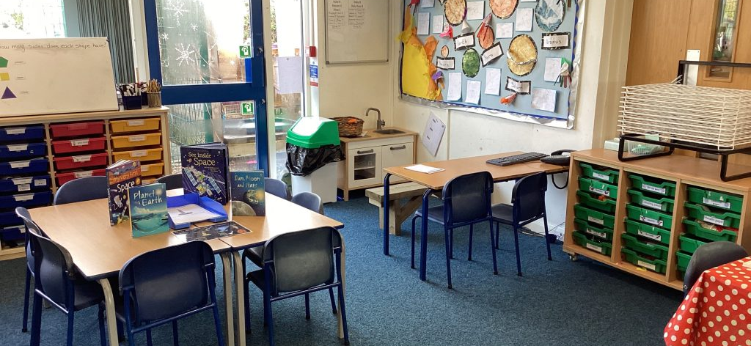
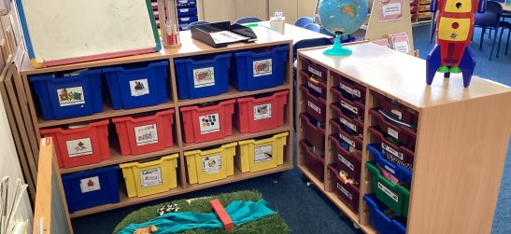
Continuous Provision
As mentioned previously, when the children star in year 1 we will have continuous provision set up in the form of ‘busy jobs’.
Continuous provision allows for:
Learning through exploration
Child-initiated learning
Promoting independence in making choices.
Becoming active learners

Slide 11
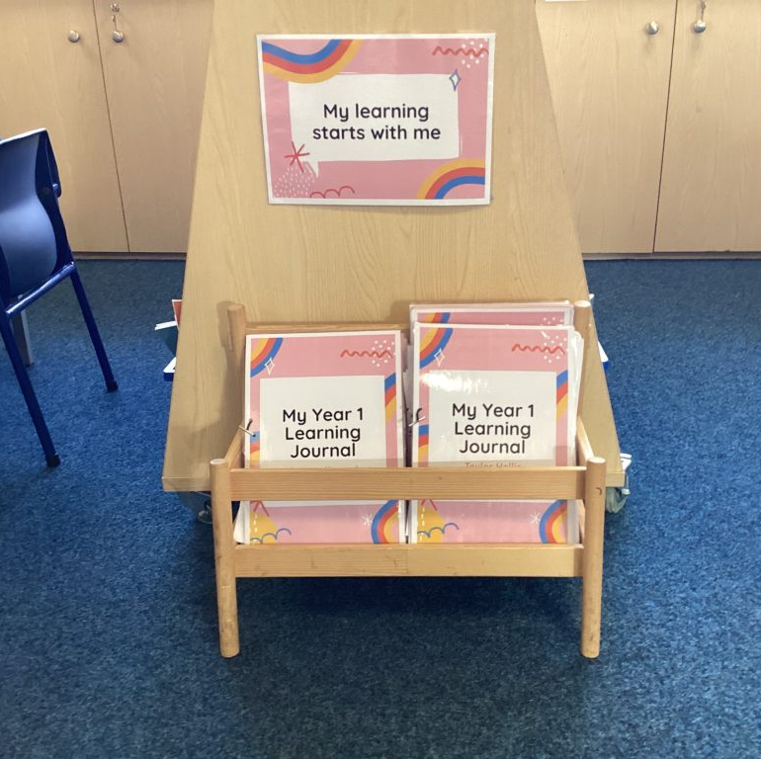
Continuous Provision
After the whole class input on the carpet the children will be split up into 4 groups. 2 groups will be working closely with an adult to deepen their understanding, and 2 groups will be working independently.
The children are responsible for their own independent learning, choosing which tasks to tackle first.
They have until the end of the week to complete the 6 busy jobs and evidence these in their learning journal or on seesaw.
By the end of year 1 (summer 2) the learning becomes more structured in the form of carousel activities ready for year 2.

Slide 12
Reading
It is important that children read with fluency and expression and shows good comprehension.
Each child’s Reading Record is checked weekly.
An adult will listen to each child read at least once a week, if we feel they need more support they will be a daily reader.
If you would like to be a parent reader, please let us know!

Slide 13
Reading Diaries
Every time you read at home with your child, please write this in their reading diaries to share with the school.
Spellings for term will be stuck in their reading diaries so that yourselves and your children can always access them.
Teachers/TA’s will write in green pen so you can see when we have also read with your child.
The stage your child is on will be written and highlighted in their reading diaries so you can also keep track of progress.
Children will also be taking home a phonics book that is in line with the sound they are learning that week, these are separate from staged books.

Slide 14
Assessment
At various points throughout the year, every half term an assessment in Maths, Science, Reading, Spelling and grammar will take place.
This is when pupils have the opportunity to show their knowledge and skills through a variety of tests and tasks.
Teachers will use this information along with observations of the children during lessons together with work in books to make an assessment of how the children are working towards the National Curriculum Year Group Expectations.

Slide 15
Homework
Year 1 are always expected to learn their spellings at home, to be tested every Friday.
Optional Homework grids can be found on the class page section of the website which is updated every half tern to reflect our current topic.
Reading with an adult 4-5 times a week is also expected to support your child in becoming an independent reader.
Timestable Rockstars and Numbots are also available for Year 1 children, the passwords are located in their reading diaries.
SpellingShed is a tool also available to help your child to practise their spellings in a fun and interactive way.
During the Summer Terms, the children will also be taking part in weekly times table tests to reflect the tables they will have been learning (2s, 5s and 10s).

Slide 16
PE
P.E is every Monday with Miss Saunders and on a Friday with Miss Sartain.
As you are aware Physical Education is an important part of your child’s curriculum and it is vital that your child brings the appropriate kit for these sessions. This includes:
Please ensure you have kit for inside and out and that it is ALL clearly labelled
Suitable footwear including plimsolls or trainers.
Hair needs to be tied back.
Earrings must be taken out.

Slide 17
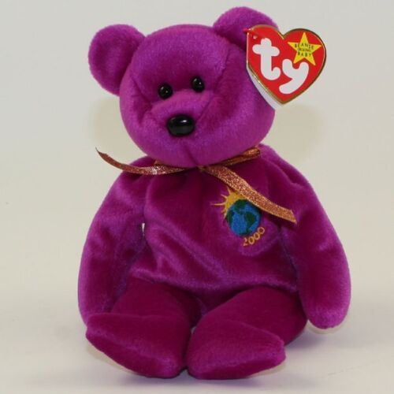
Sunshine Bear
Sunshine bear is a behaviour incentive for year 1 as well as an amazing buddy for the class.
Sunshine bear goes home with the child who has made lots of good choices throughout the week, tried hard with their learning, and completed all their busy jobs to a high standard.
While Sunshine bear is having fun over a weekend, lots of children choose to have photos taken with her for our special book.
Over half term breaks, we also have our good friend Fuzz who likes to join us on our adventures.
We appreciate all the support we can get to make this experience as magical as possible.
Sunshine bear has been on many holidays, concerts, the Kings coronation, swimming, trips to the park and the beach and many more!

Slide 18
Communication
I am on the playground in the morning when the children come into class in the morning as well as when I dismiss them at the end of the day.
You may not see me on a Tuesday afternoon, however, I will be about so if you’d like to speak to me, please just ask a member of staff.
You may use the reading diaries to record any messages, alternatively you may use edulink to contact me.
If you would like an appointment, I will be happy to arrange a time convenient to all involved.
If you have any concerns, please meet with myself first. I will escalate to other members of staff if necessary.

Slide 19
Expectations of Parents/Carers
Parents/carers have a vital role to play in their children’s education.
We will inform parents/carers immediately if we have concerns about their child’s welfare or behaviour.
The school expects parents to;
Work collaboratively with the school, so children receive consistent messages about how to behave at home and at school.
Support their child’s learning.
To co-operate with the school.
Build a supportive dialogue between the home and the school.
The policy can be found on the Parent info section of our website.

Slide 20
Safeguarding
Breakfast club starts at 7.30.
Pupils should be lined up in the morning and are taken into the building with the class teacher at 8.45, doors lock at 8.55am so please take your child round to the office if they are late.
In order to keep the children safe, if as a parent you wish to enter the building you must enter via the office.
As a parent we ask you not to fight, swear or use inappropriate behaviour on or around school grounds where children are present.

Slide 21
Extra Information
Water bottles – please name these and all clothing.
Children will be provided with pencils and all equipment that they will need for their work.
They do not need to have a pencil case in school.
Please do not bring in any toys or important belongings into school from home.

Slide 22
Your Child’s First Day!
Parents will not be permitted into the building so please say your goodbyes before Year 1 line up at the door.
Once they are in, they can hang their PE kit, book bags and coats on their pegs, lunch boxes go next to the pegs.
Your child will then be told what carpet space to sit on.
And then the day of fun activities begin!

Slide 23
How to help your child over the summer holidays
Reading! – read as much as possible, reading instructions, reading signs, book before bed.
Times tables – try to start counting in 10’s, 2’s and then 5’s
Letter formation – support the children by getting them to correct their letter formation. Make sure they’re in the correct place (e.g. sitting on the line etc)
Counting – counting to 100 and back! ☺

Slide 24
Finally
Thank you for taking time out of your day to attend today.
I look forward to getting to know your child over the year.
I am meeting with your child’s previous class teacher to learn more about your child, but, if you feel there is anything specific you would like me to know, please tell me.

